Slide 1
ECO Gaming Electronics
Next-Gen E-Commerce Platform for Sustainable Gaming Gear
Prepared by:Mehdi Touzani Idrisssi
____________________
Under the supervision of: Mr. Ammari
____________________

Slide 2
Project Overview & Vision
The Vision
Core Objectives
ECO Gaming Electronics addresses the growing carbon footprint of the gaming sector. Our mission is to deliver high-performance gaming peripherals made with recycled ocean plastics and low-impact manufacturing processes, while offering a modern, frictionless shopping experience for the conscious gamer.
• Sustainable Materials: Verified eco-friendly gaming hardware.
• Blazing Fast Performance: Optimized React storefront built with Vite.
• Secure Transactions: Ready for fully verified Stripe payment integration.
• Easy Deployment: Standardized environment configs & vercel.json setup.
• Premium UI/UX: Custom responsive design using Tailwind CSS.

Slide 3
System Architecture & Stack
Client (Frontend)
Server (API Layer)
Database & Hosting
• React with Vite
• Tailwind CSS styling
• Custom components
• Interactive Shopping Cart
• Direct-routing via Vercel edge
• Node.js & Express REST API
• Database connection pool
• Transactional order processing
• Stripe webhook endpoints
• Robust error handling
• MySQL 8 database
• Normalized schemas
• Frontend hosted on Vercel
• Environment config (.env)
• Production-ready build scripts

Slide 4
Storefront & User Flow
1
2
3
4
Discovery
Detail Page
Dynamic Cart
Checkout Flow
Users browse high-quality green hardware with specs.
Direct routing displays product specs & eco metrics.
Local state tracking stores and updates orders instantly.
Stripe Element integration secures all payment details.

Slide 5
Database Schema & REST API
REST API Endpoints
MySQL Relational Tables
GET
/api/products
Table: products
• id (INT AUTO_INCREMENT - PK)
• name (VARCHAR), price (DECIMAL)
• image_url (VARCHAR), details (TEXT)
• stock (INT)
Table: orders
• id (INT AUTO_INCREMENT - PK)
• customer_email (VARCHAR)
• total_amount (DECIMAL)
• payment_status (VARCHAR)
• created_at (TIMESTAMP)
Retrieve list of all products.
GET
/api/products/:id
Get detailed product information.
POST
/api/orders
Process order & initialize Stripe payment.

Slide 6
Deployment & Configuration
Frontend (Vercel)
Backend Deployment & Env
• Configured via root 'vercel.json'
• Custom build commands automatically process Vite React resources
• Client bundle outputted directly to 'client/dist'
• Complete route redirection ensures direct URLs like '/products/aegis-apex' resolve correctly inside single-page React Router rules
• Integration with zero env settings for easy testing deployment
• Hosted on persistent Node.js environment
• Utilizes .env configuration for DB and CORS settings
• Required Environment Variables:
- DB_HOST, DB_USER, DB_PASSWORD, DB_NAME
- STRIPE_SECRET_KEY (for real orders)
- CLIENT_ORIGIN (CORS validation for storefront)
- VITE_API_URL configured at build time

Slide 7
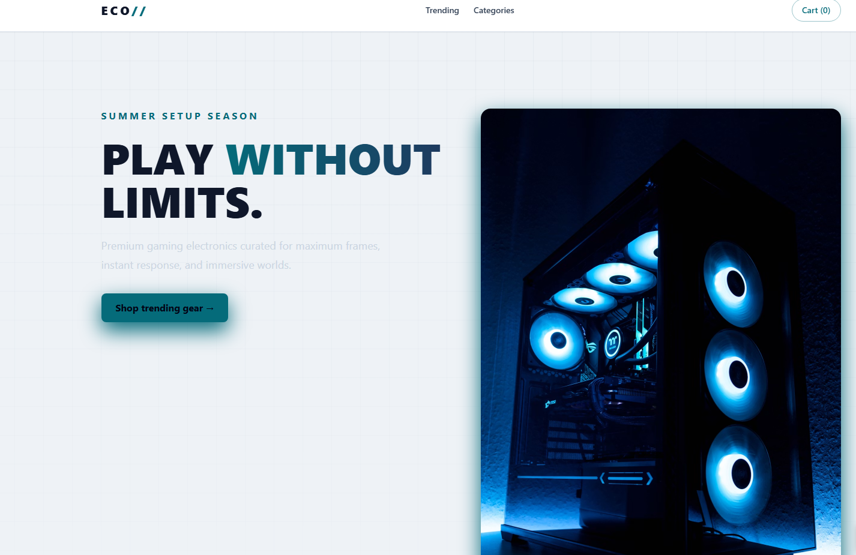
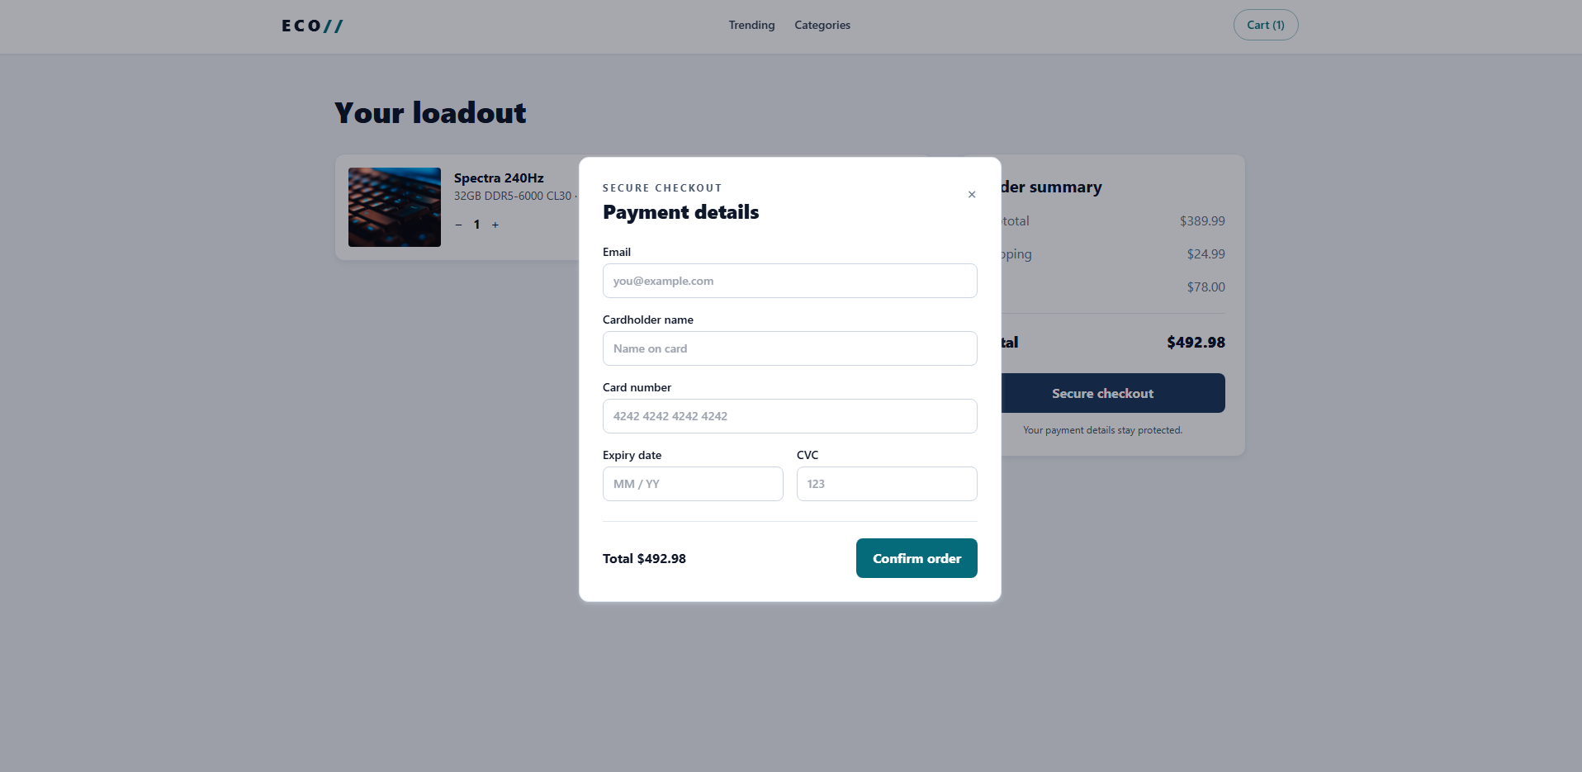
Live Storefront & App Preview
🖼️ [ Insert Storefront Screenshot here ]
(e.g., Product Catalog or Homepage view)
🖼️ [ Insert Checkout Flow Screenshot here ]
(e.g., Cart Panel or Stripe checkout preview)
🔗 Live Application Link
link to website

Slide 8
Thank You
Questions & Discussion
Prepared by: Mehdi Touzani Idrissi
____________________
Under the supervision of: Mr. Ammari
____________________

